Slide 1
intro java web api lib

Slide 2
Servlet container
JSP
Spring MVC
Tomcat, Jetty, weblogic
一般CMS (content manager system)首選

Slide 3
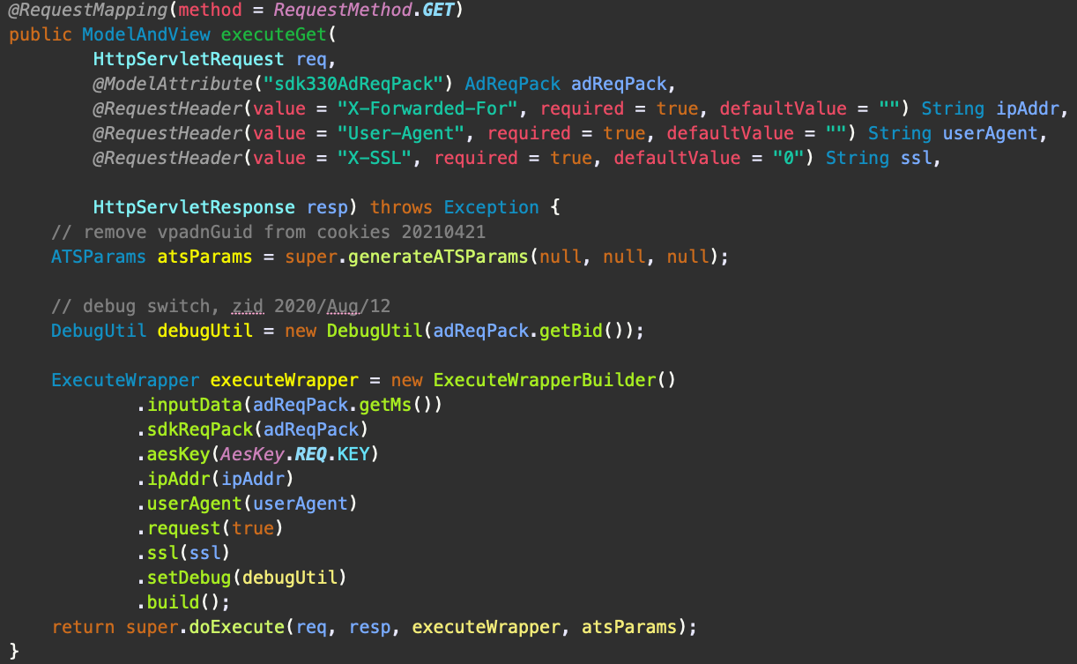
Servlet container

Slide 4
Eclipse vertx
event driven framework, run on JVM
base on Netty
透過Verticle 解耦，component之間不能互相呼叫 只能在 event bus上通知
核心實作event loop

Slide 5
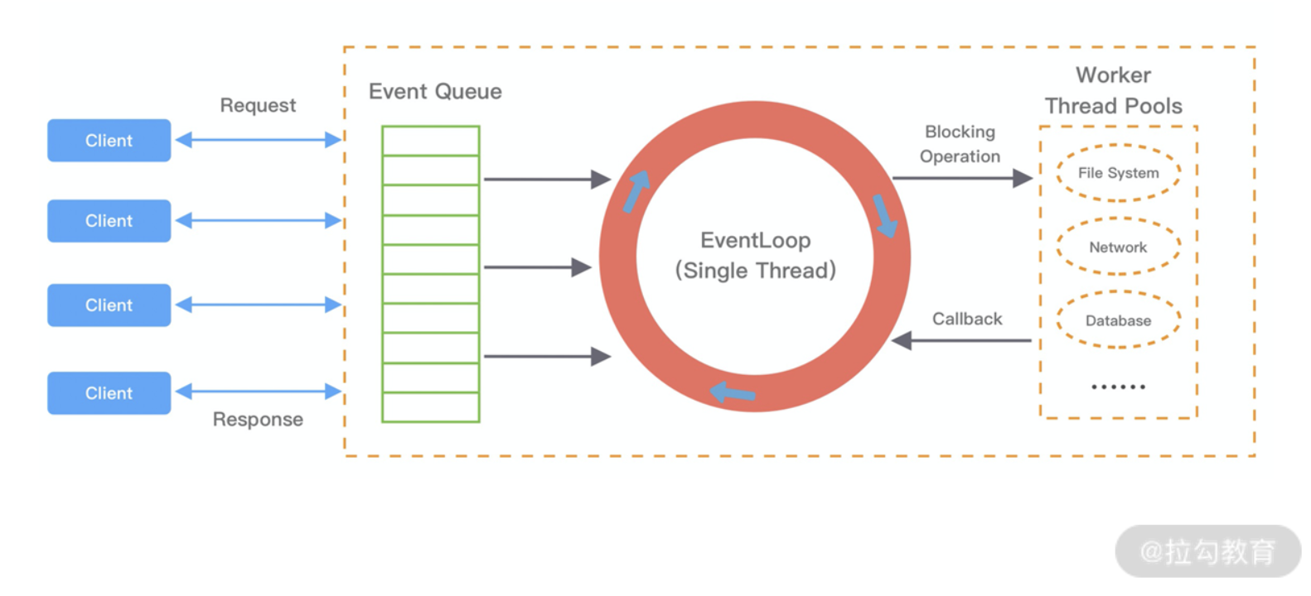
event loop

Slide 6
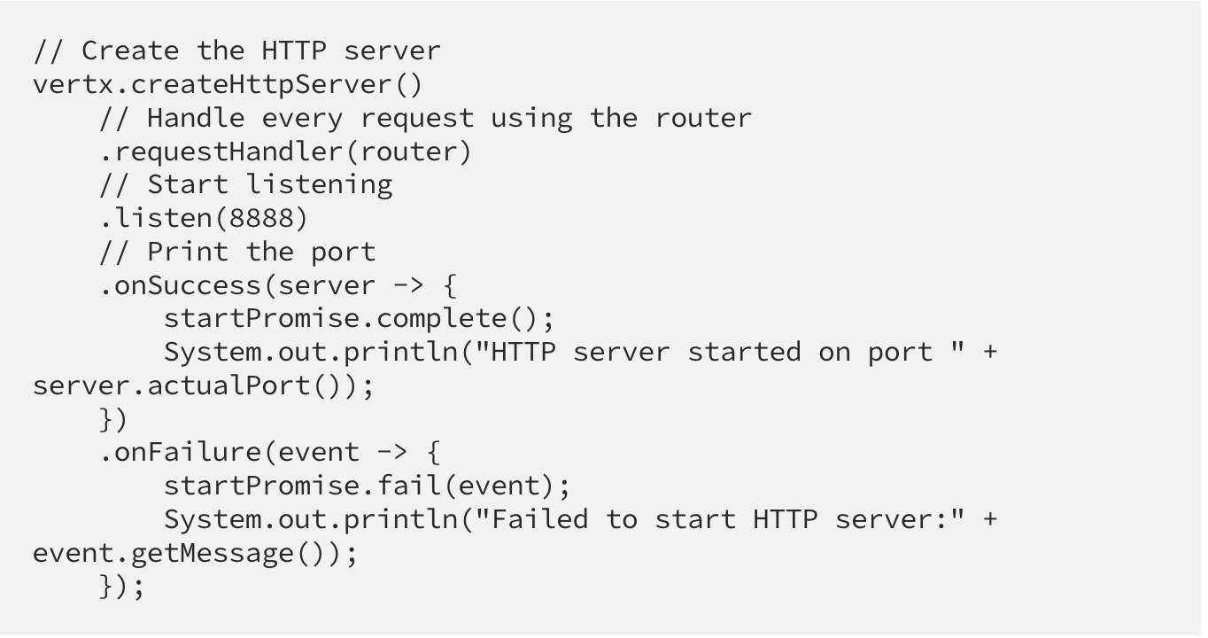
vertx start

Slide 7
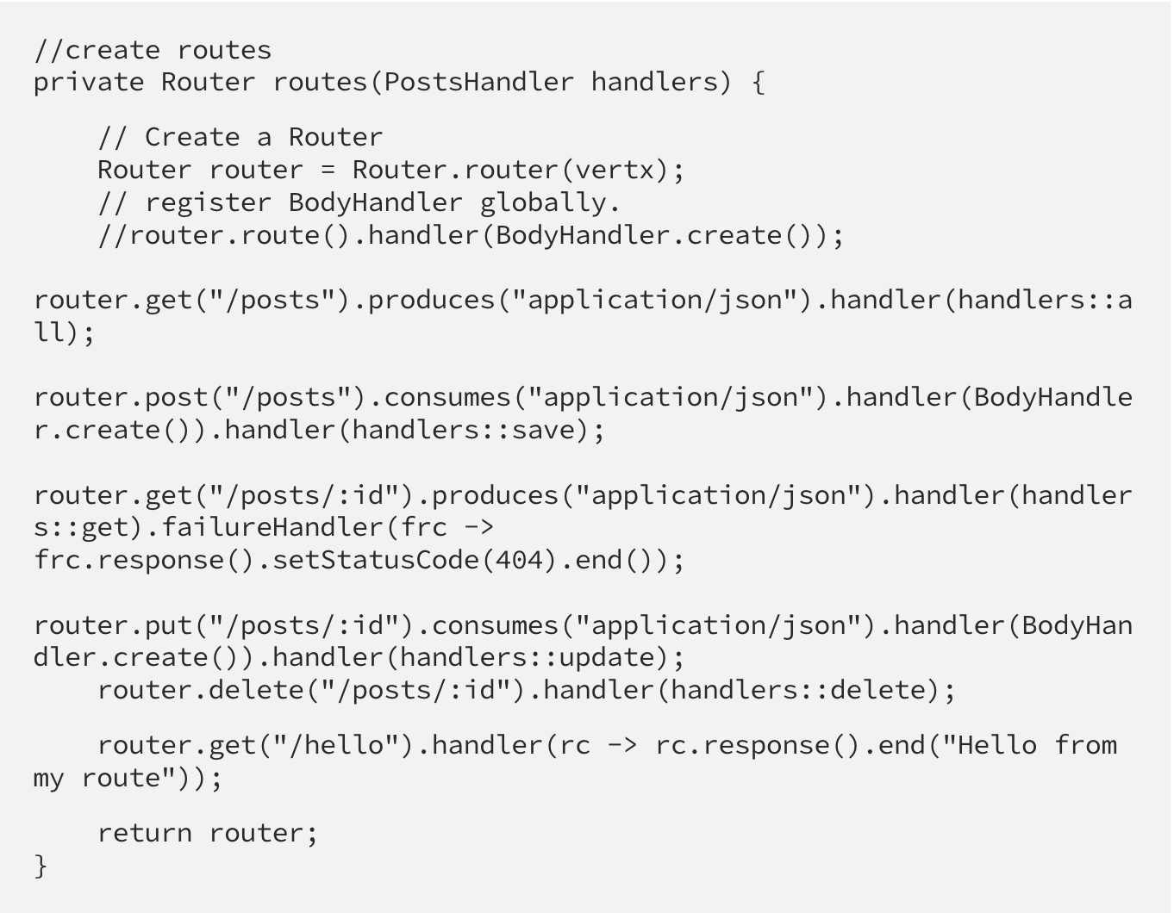
vertx router

Slide 8
本人發言不代表本人立場
vertx 底層使用netty，不受web container效能限制
restful web api MVC 比較直觀 (vertx exchange對於json處理較弱)
vertx 另外還整合了很多client , httpClient, JDBCClient, kafka….
vertx比較像是api Gateway (like nginx)
大量io首選vertx

Slide 9
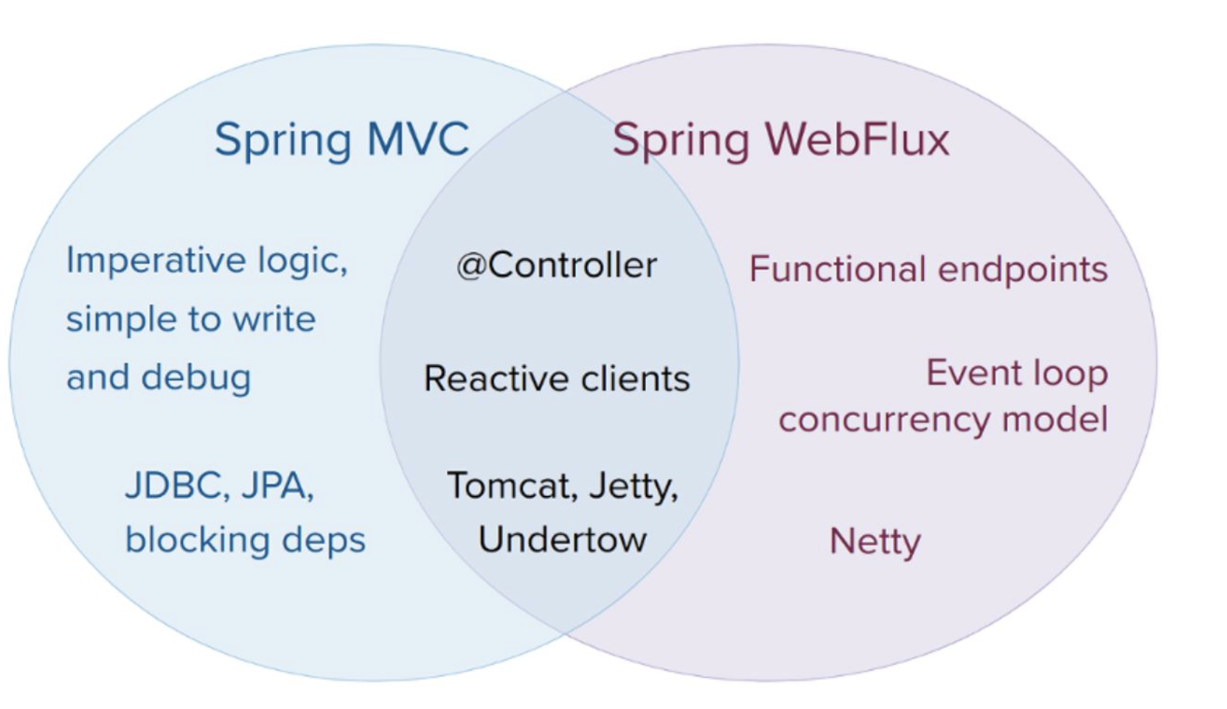
spring webflux!

Slide 10
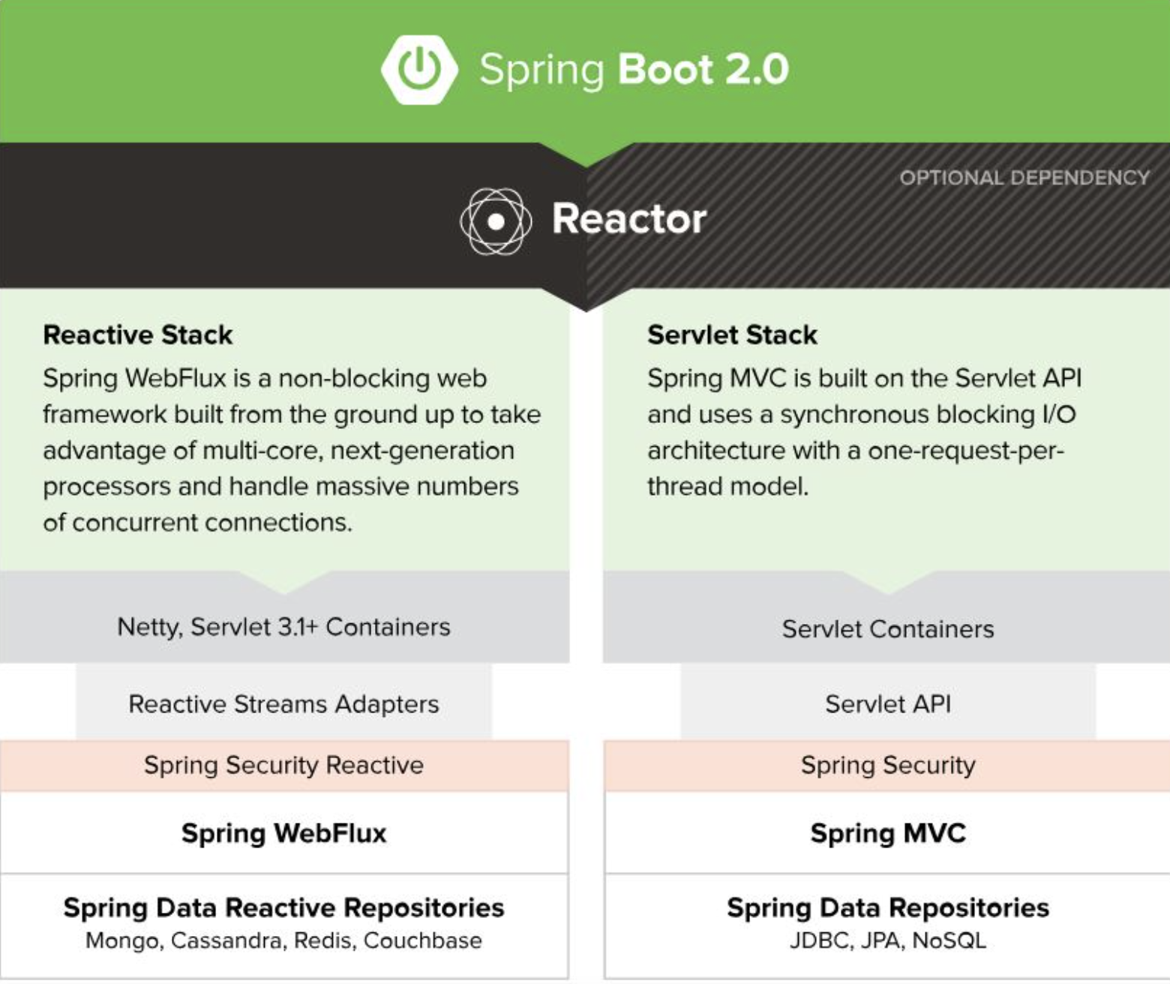

Slide 11
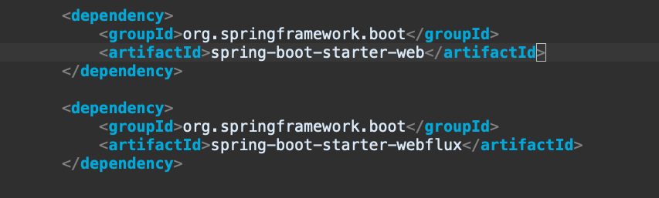
Everything is based on reactive streams publishers (Mono and Flux) making your code reactive to data being available (from a database or from another service called via HTTP as examples).
http://confluence.vpon.com/display/~alistair.shi/OnnxPOC

Slide 12
本人發言不代表本人立場
重點不是語法，而是設計思維上的變更

Slide 13
project generate
vertx: https://start.vertx.io/
webflux: https://start.spring.io/

